Slide 1

Shri Vile Parle Kelavani Mandal’s Dwarkadas J. Sanghvi College of Engineering Plot no. U-15, JVPD Scheme, Bhaktivedanta Swami Marg, Vile Parle (W), Mumbai-400056. DEPARTMENT OF ELECTRONICS AND TELECOMMUNICATION ENGINEERING Academic Year: 2017-2018

Slide 2
PROJECT PRESENTATION On Smart Surveillance using artificial neural networks
Under the guidance of
Prof. Tanaji Biradar
D.J.S.C.O.E.
Name SAP
SAMRUDDHI BHAID 60002140008
DINESH TRIPATHI 60002140111
SWAPNEL DESAI 60002158004

Slide 3
Introduction to concept
Smart surveillance is needed on international borders for 24x7 patrolling in remote areas without human intervention.
This issue caught attention due to sudden increase in trans-border infiltrations in the recent past.
The system is based on 2 artificial neural networks.
1) Human detection model 2) Face recognition model

Slide 4
Introduction
Both models have been developed on Tensorflow using python
We have used a pre-trained model (MobileNet-SSD_COCOv2) that can identify up to 90 different objects. Further, we have configured and re-trained the model for detection of and alerting on human intervention.
Simultaneously, another model built in Spyder environment uses Haar Cascade algorithm for face detection.

Slide 5
Objective
The basic motivation behind developing this model was to replace the existing CCTV systems by real-time surveillance and automatic response systems.
Additionally, the face recognition model aims at replacing the RFID system making the military bases much more secure to infiltration.
These two models combine to form a robust system that can be used in various scenarios as discussed in the applications

Slide 6
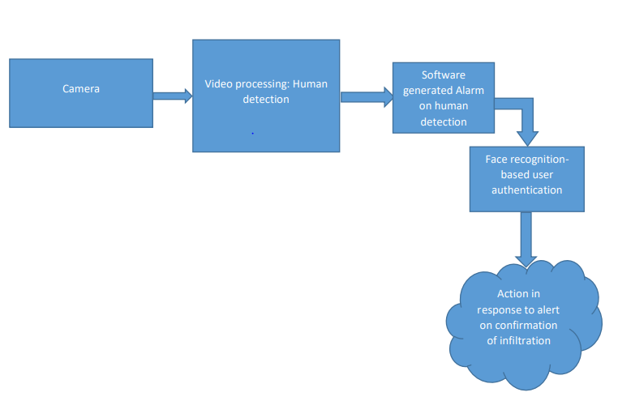
Project Flow

Slide 7
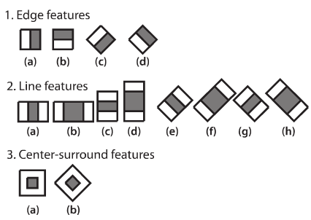
HAAR CASCADE
OpenCV's algorithm is currently using the following Haar-like features which are the input to the basic classifiers:
Haar features are just like our convolutional kernel. Each feature is a single value obtained by subtracting sum of pixels under the white rectangle from sum of pixels under the black rectangle.
It is a machine learning based approach where a cascade function is trained from a lot of positive and negative images. It is then used to detect objects in other images.
OpenCV already contains many pre-trained classifiers for face, eyes, smile etc. Those XML files are stored in opencv/data/haarcascades/ folder

Slide 8
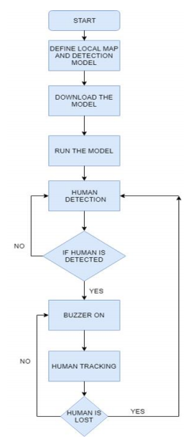
Human detection algorithm

Slide 9
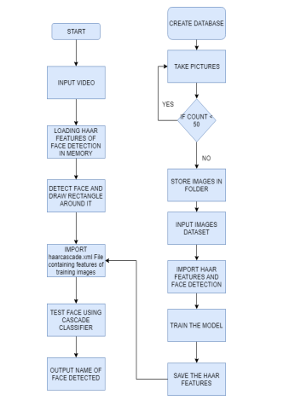
Face recognition algorithm

Slide 10
stages of implementation
Webcam surveillance
Webcam interfacing with artificial neural network
Artificial neural network for generic object detection, set up and trained using train_net.py and test_net.py
Implementation of trained and tested models on a random dataset and modification as per the performance reports obtained using solver.prototxt and train.prototxt tools
Successful detection of humans in a frame achieved through re-configuration of object detection model
Integration of software alarm on human detection into the model
Human detection followed by running of face detection algorithm on detected human.
If face matches with registered face, alarm stops.
If face is unrecognized, then security breach is confirmed.

Slide 11
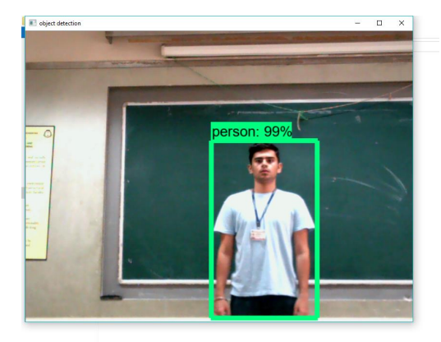
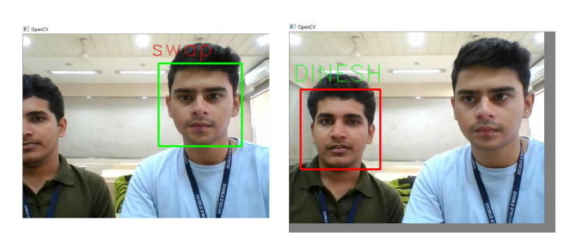
output
Output figure 1
Output figure 2

Slide 12
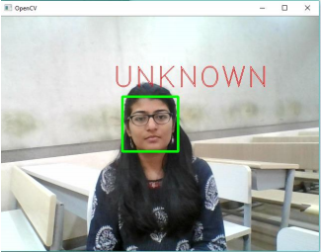
Output figure 3

Slide 13
Future scope
Integration of wireless and night vision cameras instead of wired camera used in the prototype
Development of model for simultaneous face recognition of multiple faces in a frame
Training output of neural network to drive a relay gun to start automatic firing on intrusion confirmation.

Slide 14
References
Ross Girshick Microsoft Research by rbg@microsoft.com (Girshick, Ross. "Fast R-CNN" 2015)
Sentdex video tutorials for artificial intelligence (Youtube)
Automatic security system for recognizing unexpected motions through video surveillance
doi.org
Pantech smart surveillance solutions
Survey paper on Smart surveillance system (github)
Report on “human detection” by Jignesh S. Bhatt (IIT Vadodara)
Smarter-control-border-patrol by Engineering Arizona
Detection of enemy intervention in border and battle fields using smart dusttechnology.pdf
Explanation of classification and feature extraction for human detector. Pdf
Human detection and recognition using open source computer vision library.pdf

